Slide 1
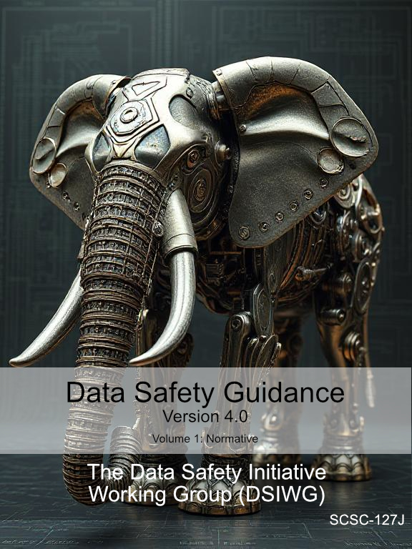


How to Be Data Safe
Timothy Rowe
Notes:
I’ll talk about what data safety is, and Divya will talk about what can be done to assure it. Point out that data safety can be intimately tied in with overall safety…

Slide 2
How to Be Data Safe
Timothy Rowe

Slide 3

How Does Data Cause Hazards
Only as part of a system (like software)
Can be a direct relationship to harm
Poncheon bombing
Wrong bombing coordinates
Can be a complex relationship to harm
Post office Horizon system
Hardware issue triggered a software issue that triggered a database issue that triggered an inappropriate institutional response
Notes:
Poncheon: On the 6 March 2025, two South Korean KF-16 fighters released four MK-82 bombs each on a civilian area in Poncheon, South Korea, during a live-fire military exercise. The bombing injured nearly 30 people, seriously, and caused extensive property damage. Initial investigations found the pilot of one of the KF-16s entered the wrong coordinates for a bombing site.
We don’t know whether there were any other factors led to the wrong coordinates being entered.
Horizon: That’s just one of the data issues with Horizon
Initial data issue involved database transaction not being atomic.

Slide 4
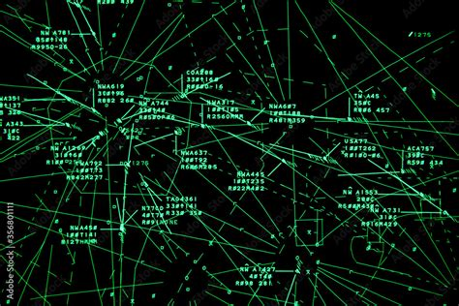
Is Data Safety Already Managed?
Often, Yes
E.g. typical hazard identification processes will include consideration of hazardously misleading information
But not always
Some types of data issue can be tricky to spot
Unexpected relationships (Tandem Insulin Pump)
Change of use not properly analysed (Ariane 5)
Etc.
Notes:
Tandem Insulin Pump – over 300 injuries, some requiring hospitalisation

Slide 5

So We’ve Produced Guidance!
Data Safety Initiative Working Group set up in 2012
To formulate best practice
Combines industry and academia
New version 4.0
Split into 3 volumes
Harmonised content
Increased normative content

Slide 6
Structure of the Guidance
Volume 1: What
Principles
Objectives
Volume 2: How
Process
Activities
Detailed Guidance
Volume 3: Why
(Mainly!)
Scenarios
Incidents and accidents
This workshop concentrates on How
Notes:
Hand over to Divya

